Slide 1
Predictiong Used Car Price
By: Rajnish Kashyap

Slide 2
Contents :-
This Presentation contains several topics for discussion but main topics are:
Dataset Introduction | We aim to build a machine learning model that predicts the selling price of used cars based on features like age, fuel type, transmission, and more. This helps sellers, buyers, and dealerships make informed pricing decisions.
Exploratory Data Analysis (EDA) | We performed data cleaning, type conversions, and outlier removal. Key patterns were observed regarding price trends with respect to fuel type, car age, kilometers driven, and ownership history.
Data Visualization | Visualizations such as count plots, bar charts, and scatter plots were used to understand the relationships between car features and selling prices. These helped in identifying influential variables.
Feature Engineering | New features like car age were created from the manufacturing year. Categorical variables such as fuel type and transmission were label encoded to be usable by machine learning models.
Model Implimentation & Evaluation | We applied multiple models including Decision Tree, Random Forest, and XGBoost. Performance was evaluated using metrics like Mean Squared Error, MAE, and R² score. XGBoost showed the best results.
Hyperparameter Tuning | RandomizedSearchCV was used to fine-tune model parameters. This improved performance further by optimizing key settings in Random Forest and XGBoost, leading to more accurate predictions.

Slide 3

01
Dataset Introduction

Slide 4
Objectives
Our problem
The goal
The used car market is highly dynamic, influenced by several factors such as mileage, model year, fuel type, and ownership history.
A lack of intelligent pricing strategies can result in:
Undervalued or overpriced listings
Poor inventory movement
Missed business opportunities
The goal of this project is to build a machine learning
model that predicts the selling price of a used
car using various features such as car name, age,
kilometers driven, fuel type, transmission, and
ownership details.
With the help of this model:
Dealers can automate price estimations based on
objective data.
Buyers/sellers gain a better understanding of fair
Value.
Businesses can uncover patterns for pricing strategy Refinement.

Slide 5
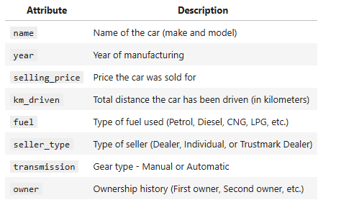
Dataset Description
Type of Machine Learning Task
This is a Supervised Learning task, specifically a Regression problem, where the aim is to predict a continuous numerical value — the selling price — using features of the car.
We will experiment with
models like:
Decision Tree Regressor
Random Forest Regressor
XGBoost
and evaluate them using metrics such as:
Mean Absolute Error (MAE)
Mean Squared Error (MSE)
R² Score

Slide 6
Basic Info about Dataset
Total Rows & Total Columns
Initial Column-Wise Summary
Dataset contains total: 1064 Rows
Dataset contains total: 19 Columns
FuelType: 1 missing value
TransmissionType: significant missing values (only 350 non-null)
CngKit: sparse data (only 22 non-null)
Data cleaning, transformation, and imputation will be required before model training.
Descriptive Statistics Summary
- The average used car in the dataset has been driven approximately 52,807 kilometers.
- The ModelYear ranges from 2003 to 2023.
The Warranty column is binary (0 or 1).
The QualityScore ranges from 0.0 to 9.4.
All numerical fields appear to be on valid scales

Slide 7
02
Exploratory Data Analysis

Slide 8
Handling Missing Values –Data Cleaning
Missing Value Summary
Handling Missing Value
- FuelType: 0.09% Missing values.
- TransmissionType: 67% Missing values.
- CngKit: 98% Missing values.
FuelType: Missing Value is imputed with ‘PETROL’ (most common value of columns)
TransmissionType: For this columns all the missing values are imputed using mode (most frequent value of column).
CngKit: This Column has high percentage of missing value and the impact of this feature is very minimal. So, removed due to excessive sparse.

Slide 9
Target Variable Cleaning: ‘PRICE’
Why Cleaning ?
Cleaning Strategy
Cleaning Strategy
This columns is our Target Variable (Prediction column), it’s Dtype is object.
For that we have to convert it’s Dtype to integer.
Values of this column: 5.75 Lakhs, 4.35 Lakhs, 4.7 Lakhs, etc.
A custom function clean_price() was applied to:
Detect the presence of the term "Lakhs" and convert it to numeric format by multiplying with 100,000.
Remove commas and leading/trailing spaces from plain numerical strings.
Convert the final cleaned string to a float value.odel performance.
After cleaning the Price column, we conducted a statistical summary to understand its distribution and value range.
Count: 1,064 listings
Mean Price: Rs. 8.35 Lakhs
Median (50th percentile): Rs. 6.75 Lakhs
Minimum Price: Rs. 95K
Maximum Price: Rs. 85 Lakhs
Std Deviation: Rs. 5.72 Lakhs

Slide 10
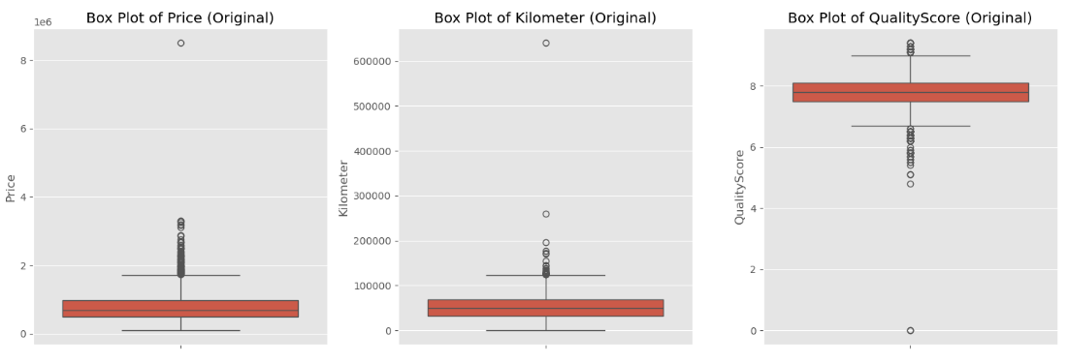
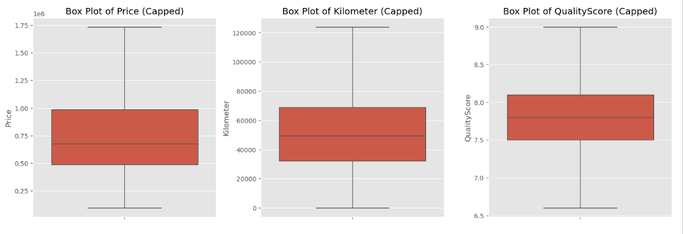
Outlier Analysis
After Capping

Slide 11
Minimal Feature Engineering
To enhance the dataset and prepare it for modeling, a few minimal yet impactful feature engineering steps were applied.
Car Age Feature
Car Age Summary Statistics
This feature captures how old a car is as of the year 2025, which is often a stronger predictor of price and quality than raw manufacture dates.
The original ManufactureDate column was dropped as it is now redundant.
Mean: 8.13 years
Min: 2 years
Max: 22 years

Slide 12
Grouping Values
To reduce noise and avoid high cardinality in categorical variables, we grouped less frequent categories under a generic label 'Other'.
Model Column
Variant Columns
Kept Top 10 most frequent models.
All other models were grouped under ‘Other’.
Kept Top 10 most frequent variants.
All other variant were grouped under.
This simplification helps:
Improve model performance and generalization.
Reduce the risk of overfitting on rare, less informative categories.

Slide 13
03
Data Visualization

Slide 14
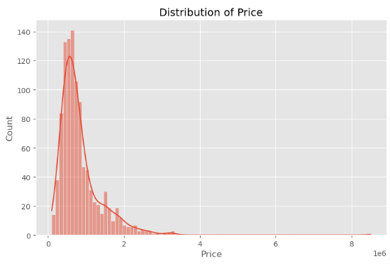
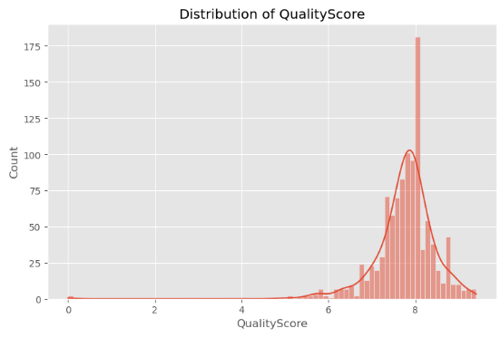
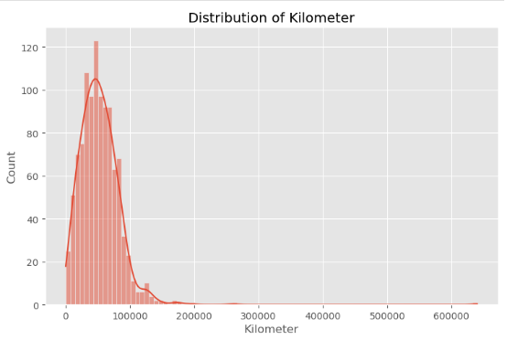
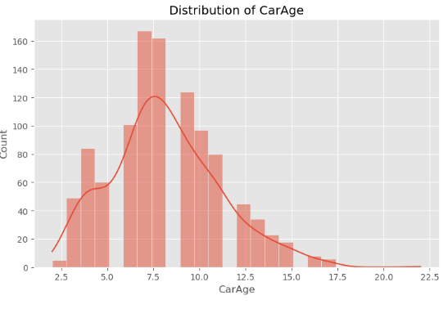
Data Visualization
Distribution of Price
Distribution of QltScore
Distribution of Kilomtr
Distribution of CarAge

Slide 15
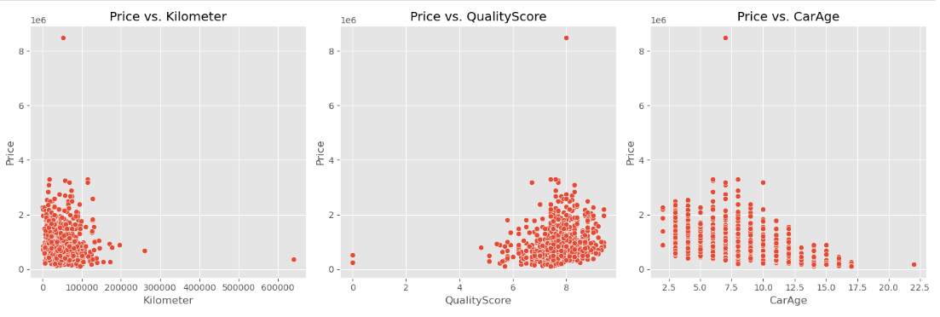
Data Visualization
Price vs. Kilometer
Price vs. QualityScore
Price vs. CarAge

Slide 16
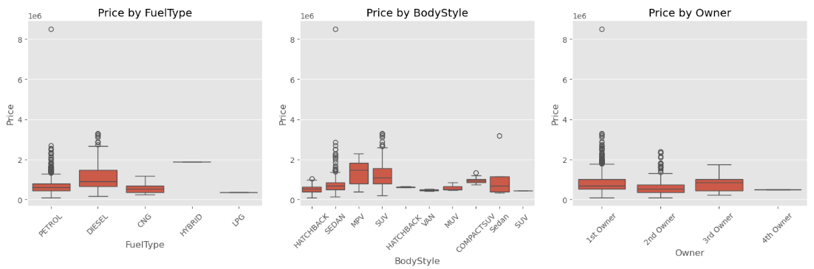
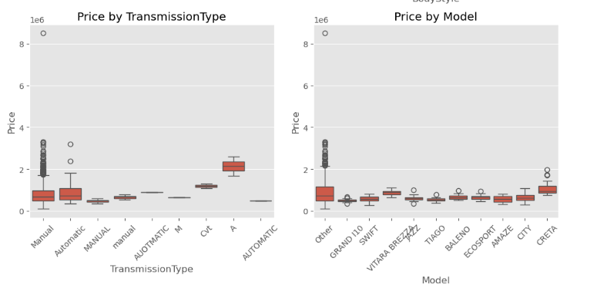
Data Visualization
Price by FuelType
Price by BodyStyle
Price by Owner
Price by TransmissionType
Price by Model

Slide 17
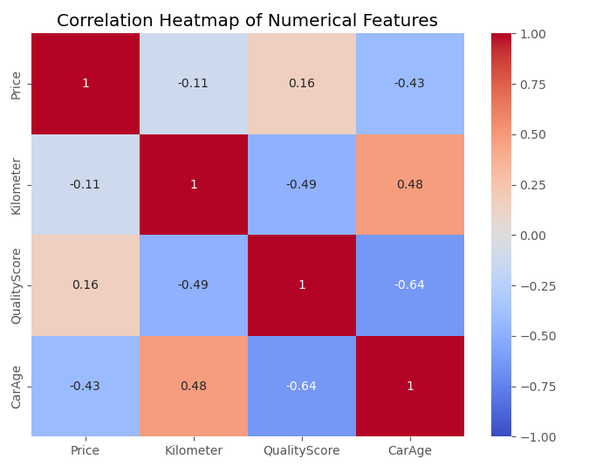
Data Visualization
HeatMap
Price is:
Negatively correlated with CarAge (-0.43).
Slightly positively correlated with QualityScore (0.16).
Slightly negatively correlated with Kilometer (-0.11).
Strongest correlation: CarAge vs QualityScore (-0.64)

Slide 18
04
Feature Engineering

Slide 19
Categorical Column Preprocessing
To prepare the dataset for machine learning, categorical variables were encoded using two strategies:
Label Encoding (Ordinal)
One-Hot Encoding (Nominal)
Owner column was mapped to reflect ownership levels:
‘1st Owner’ – 0
‘2nd Owner’ – 1
‘3rd Owner’ – 2
This encoding retains the ordinal nature of ownership.
Remaining categorical columns (excluding CngKit, which was dropped earlier) were one-hot encoded:
Columns Encoded: ['Company', 'Model', 'Variant', 'FuelType', 'Colour', 'BodyStyle', 'TransmissionType', 'DealerState', 'City’]
drop_first=True was used to prevent multicollinearity and dtype=int ensures consistent numerical dtype.

Slide 20
Advanced Feature Engineering
Interaction Term: FuelType X BodyStyle
Purpose: Captures interaction effects between fuel type and body style that may influence price, performance, or demand.
Binning Kilometer into Categories
Purpose: Converts a wide range of kilometer values into categories to reduce noise and reveal broader usage patterns.
Aggregation: Average Price per Company
Purpose: Adds a brand-level pricing signal that reflects overall market value for each company.

Slide 21
05
Model & Evaluation

Slide 22
Scaling & Train – Test Split
Numerical Column Selection and Missing Value Imputation
Selected the following numerical columns (excluding the target Price) for scaling:
'Kilometer', 'ModelYear', 'Owner', 'Warranty', 'QualityScore', 'CarAge', 'Company_Avg_Price’
Any missing values (NaNs) in these columns were imputed using the median to avoid bias introduced by extreme values.
Feature and Target Separation
The dataset was split into:
Features ( X ): All columns expect ‘PRICE’
Target ( y ): The Price column

Slide 23
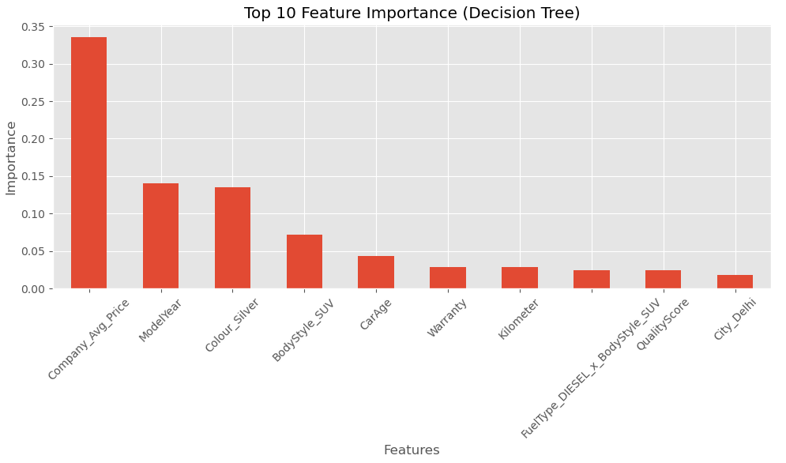
Scaling & Train – Test Split
Top 10 Feature Importance (Decision Tree)

Slide 24
Modeling and Evaluation
Models Used
Three regression models were initialized with specific parameters:
Tuned Random Forest:
n_estimators=200, max_depth=20, min_samples_split=5, random_state=42.
Decision Tree:
Default configuration with random_state=42
XGBoost:
n_estimators=200, max_depth=5, learning_rate=0.1, random_state=42
Evaluation Metrics
MSE (Mean Squared Error): Penalizes larger errors more
MAE (Mean Absolute Error): Average magnitude of errors
R2 (R-squared Score): Proportion of variance explained (closer to 1 is better)

Slide 25
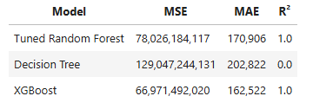
Modeling and Evaluation
Model Performance Comparison
Observations
XGBoost showed the best performance with the lowest MSE and MAE.
Tuned Random Forest also performed well with a perfect R² but slightly higher error values than XGBoost.
Decision Tree had significantly worse performance, indicating potential overfitting or underfitting with default parameters.

Slide 26
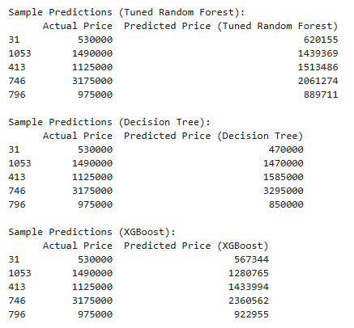
Modeling and Evaluation
Sample Prediction
Observations
XGBoost demonstrates consistent performance, keeping predictions close to actual values but tends to slightly underestimate high prices (e.g., 3175000 predicted as 2360562).
Tuned Random Forest also shows good accuracy overall, although it overestimates in some cases (e.g., 1125000 predicted as 1513486).
Decision Tree, while producing reasonable predictions, is comparatively less accurate with higher variance across example.

Slide 27
06
HyperParameter Tuning

Slide 28
HyperParameter Tuning
Sample Prediction
Observations
XGBoost demonstrates consistent performance, keeping predictions close to actual values but tends to slightly underestimate high prices (e.g., 3175000 predicted as 2360562).
Tuned Random Forest also shows good accuracy overall, although it overestimates in some cases (e.g., 1125000 predicted as 1513486).
Decision Tree, while producing reasonable predictions, is comparatively less accurate with higher variance across example.

Slide 29
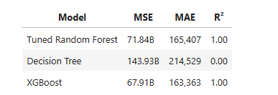
HyperParameter Tuning
Evaluation After Grid Search
Observations
XGBoost continues to perform competitively with a low MSE and MAE, maintaining a perfect R² score.
Tuned Random Forest remains highly accurate and closely matches XGBoost’s performance, with a slightly higher MSE.
Decision Tree, remains underperforming with no improvement in R², indicating it is not suitable for this regression task.

Slide 30
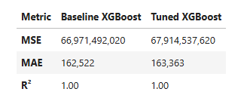
HyperParameter Tuning
Model Performance Comparison (XGBoost)
Observation:
After improved hyperparameter tuning, the XGBoost model maintained a perfect R² score, confirming its strong fit.
However, MSE and MAE slightly increased compared to the baseline model, indicating no significant gain from further tuning.
Sample predictions from both models remain highly accurate, but the baseline version demonstrates slightly lower error values.

Slide 31
Conclusion
While the tuned XGBoost model continues to perform excellently, the baseline XGBoost model actually performs marginally better in terms of error metrics.
Therefore, the baseline XGBoost model is selected as the final model due to its slightly superior predictive performance and reliability.

Slide 32
Thank You!
By: Rajnish Kashyap

